Slide 1
E-learning
Appropriately Trained & Developed
NHS fife
For further information please contact
Jackie Ballantyne,
Learning and Development Officer (e-learning)
01592 643355 ext 28795,
jackie.ballantyne@nhs.net
Enhanced e-learning uptake with over 20% increase in e-learning on 2013 and over 17,000 hours of e-learning and 14,720 courses successfully completed. In the last year NHS Fife has created 12 new e-learning modules, with 10 further to follow as part of the development of your e-learning resources.

Slide 2
E-Learning Provision
In a climate of constrained resources and service pressures it was considered essential that learning and development provision was delivered efficiently and effectively to meet identified needs for both compliance training and continuing personal and professional development.
The expansion of e-learning provision (over 80 programmes) has been positively received by staff who welcomed the increased access to learning opportunities and by NHS Fife which benefited from cost savings of £60,000 of non cash releasing efficiency savings.
The development of a blended learning approach across a range of subject areas has been a central focus of our approach and has been welcomed by subject matter experts and staff alike.

Slide 3
Local development
Local development of e-learning materials is prioritised to ensure alignment to organisational priorities / high impact areas. A structured quality assurance process has been developed to ensure consistency of design and build, content accuracy, and relevance to NHS Fife staff. End user feedback is regularly collected and has been extremely positive about accessibility, user friendliness and the overall learning experience.
We continue to further develop the range of e-learning material available to NHS Fife staff, the adoption of blended learning approaches and enabling a range of our care partners (eg: primary care , staff in partner agencies, voluntary groups and carers) access to NHS Fife e-learning provision.

Slide 4
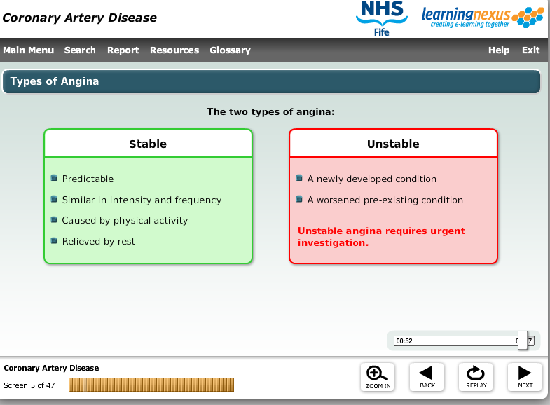
Sample Module – coronary artery disease

Slide 5
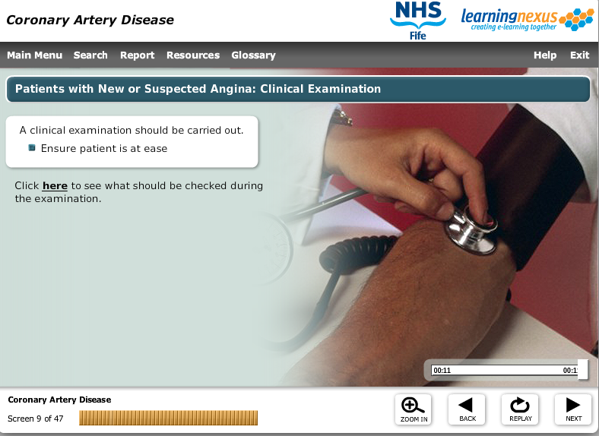

Slide 6
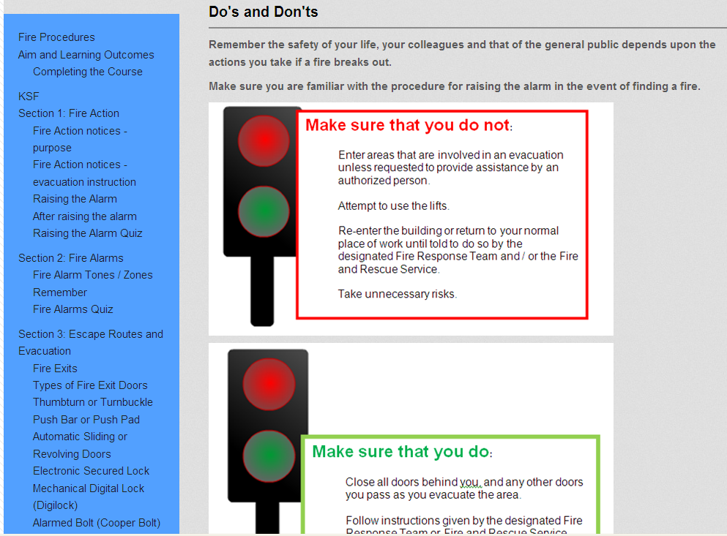
Fire module

Slide 7
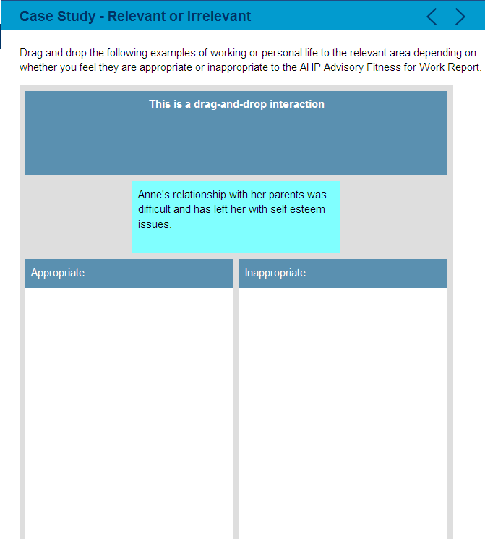
Ahp advisory fitness for work report

Slide 8
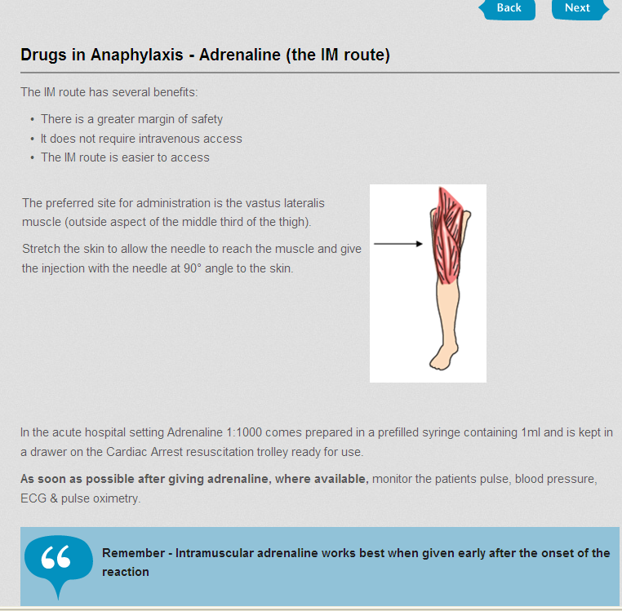
Anaphylaxis module

