Slide 1
VALUES DASHBOARD
Treated Fairly & Consistently
NATIONAL WAITING TIMES CENTRE
Developed their own Values Dashboard to measure if they are living their values from a staff, patient, visitor and delegate/guest perspective. Their 5 values are displayed in a visual and interactive package with the most important live data considered collectively. The dashboard is used as an analytical tool with scrutiny at a range of Board and Governance Groups.

Slide 2
NWTC Values Dashboard
Developed their own Values Dashboard to measure if they are living their values from a staff, patient, visitor and delegate/guest perspective.
Their 5 values are displayed in a visual and interactive package with the most important live data considered collectively.
The dashboard is used as an analytical tool with scrutiny at a range of Board and Governance Groups. Screenshots of the values dashboard can be viewed in the pages that follow.
The data is updated on a quarterly basis at present although the intention is to move to monthly data uploads.
The dashboards are an easy to use, visual tool to illustrate how as a Board the National Waiting Times Centre is living its values.

Slide 3
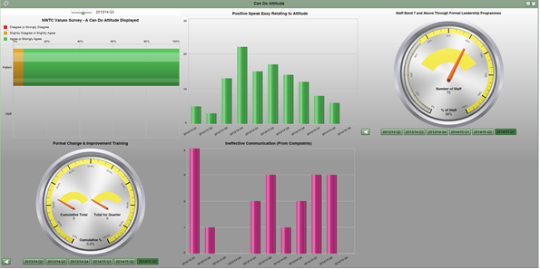
Can be attitude

Slide 4
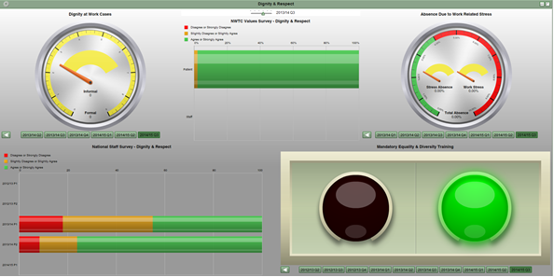
Dignity & respect

Slide 5
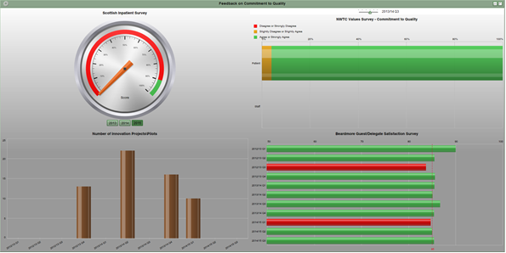
Feedback on commitment to quality

Slide 6
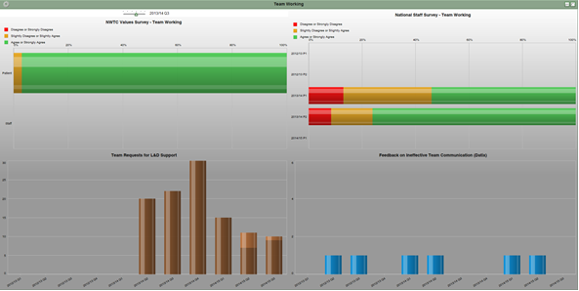
Team working

Slide 7
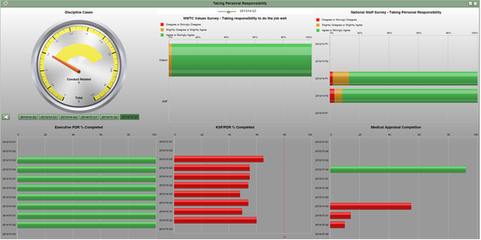
Taking personal responsibility

Slide 8
Evaluation
The Dashboards are scrutinised at Board Governance Committees on a regular basis. This allows the data to be questioned and trends identified by Board Members, the Senior Management Team and Partnership. This then in turn will identify where support can be provided to teams in the Board.
If for example cases of work related stress increased this could be identified by area. The dashboards can then be cross referenced with staffing levels by area and bed occupancy to identify what may be impacting upon the staff members stress levels.
The national staff survey results are also entered into the dashboard and comparisons used against previous results. This helps to shape the staff governance action plan for the coming year.

Slide 9
Moving forward
The Dashboards are in the process of evolving as we are moving onto a new dashboard platform and examining how we can automate the population of them.
This is the first time any measurement has been attempted in NHS Scotland for values. The Board is very proud of the innovative work it has done around the values dashboard and is now focused on how we further develop and innovate this for the future and for the benefit of all patients and staff employed in the Board.

