Slide 1
Insert local IJB logo
Insert revised national iMatter staff image
Implementing iMatter in xxx HSCP
Managers’ Development Workshop
Notes:
Welcome to this Workshop session about iMatter, the continuous improvement model that is currently being rolled out in xxx HSCP. Acknowledge that to date iMatter has been a health initiative but long-term there is benefit in extending inclusion to all working within the Health & Social Care sector.
Confirm if introductions are needed.
You were all sent pre-reading (optional).
Provide verbal feedback of current Board status and implementation (optional).
This session is in the format of a presentation and a practical interactive session. It is a safe environment to discuss any concerns you as team managers may have.

Slide 2
Today will provide you with an opportunity to:
Understand what is employee engagement and its potential impact on staff and patients.
Familiarise yourselves with the iMatter continuous improvement model and your role as a line manager/ team leader/ supervisor.
Consider how to successfully implement & embed iMatter within your own team(s).
Notes:
In this session we will cover:
Understand what is employee engagement and its potential impact on staff and patients.
Familiarise yourselves with the iMatter continuous improvement model and your role as a line manager/ team leader. supervisor.
Consider how to successfully implement & embed iMatter within your own team(s)
iMatter is a process that allows views on experiences at work to be gathered at team level, then used as the basis for development work in teams. It was originally introduced for NHS-employed staff from January 2015. This is with the intention of understanding and supporting continuous improvements in employee engagement, recognised from research as a key driver of experience for those we provide care for and their families.
Group discussion:
What do you know about iMatter?
What would be helpful for you to take away today?

Slide 3
Ways of Working
Give full attention when others are speaking
Respect and take on board each others varying perspectives, views and opinions
Create a safe environment to talk openly and honestly with each other
Think sensitively and be constructive
Focus on issues, not individuals
Remain positive and/or focus on how to turn what may seem like a negative into a positive outcome individually and as a team
Mobiles (if possible) on silent
Notes:
WAYS OF WORKING - Whole group discussion
During the discussions today, we will be asking you to share your experiences. This may include some sensitive issues. We would ask you to agree that issues discussed in the room stay in the room unless it is explicitly agreed otherwise. Only share what you feel safe to share. These are some examples of ways of working that groups have felt useful to sign up to during the session. Have a read of them – are the group willing to sign up to these for the session? Any additions or amendments?
The discussions are really important in terms of exploring the area you work in and how it feels.

Slide 4
Purpose
Process
Notes:
This session is split into two parts:
The first part focuses on the purpose of iMatter and why measuring and improving staff engagement is important for you in your teams.
The second part looks at the process in more detail, particularly thinking about you as a manager setting the conditions for a successful implementation within your team.

Slide 5
Public Bodies (Joint Working) (Scotland) Act 2014
Healthy Organisational Culture
We will respond to the needs of the people we care for, adapt to new, improved ways of working, and work seamlessly, with colleagues and partner organisations.
Together, we will create a great place to work and deliver a high quality healthcare service which is among the best in the world.
People who work in health and social care services feel engaged with the work they do and are supported to continuously improve the information, support, care and treatment they provide.
Notes:
The Christie Commission report in 2011 set out the future direction for the provision of integrated Health & Social Care services.
The National Health and Wellbeing Outcomes document sets out the framework for delivering these services. Outcome 8 that you can see here is a commitment to developing a healthy organisational culture through staff engagement.
[Optional] – for those of you with an NHS background, you might be familiar with the Workforce 2020 Vision national document. There are 5 development strands, one of which is in relation to a healthy organisational culture - aimed at ensuring staff feel valued, listened to, involved in decisions and treated with dignity and respect.
There is a strong correlation between the two documents around staff experience and engagement.
iMatter has been developed by the Scottish Government as a team based employee engagement tool, and the implementation of iMatter in xxx HSCP offers an opportunity to understand where teams are currently (a baseline) in moving forward as new working arrangements become embedded in the Partnership.

Slide 6
Insert HSCP logo
Staff Governance Standards
Local Values
Informed
1.
Involved in Decisions
2.
Appropriately Trained
3.
Safe Environment
4.
Treated Equally
Notes:
Placeholder for Boards to insert slide(s) around local Culture and Values work that iMatter aligns with / supports – both NHS and Local Authority.

Slide 7
Discussion
What does Employee Engagement mean to you?
How does this compare to the definition below (from ‘Engaging for Success’ report?
What impact have you seen when working in areas where engagement is high or low?
“A workplace approach designed to ensure employees are committed to their organisations’ goals and values, motivated to organisation success, and are able at the same time to enhance their own sense of well-being”
Clarke & MacLeod (2009)
Notes:
Group Discussion –
What does Employee Engagement mean to you? (max. of 5 minutes)
Look for answers such as:
Commitment to organisations aims, motivation to do the job well
Supports a positive and productive workplace from which service users / patients and employees benefit
Regular feedback, visible team working, ideas and suggestions being listened to and acted on
Feeling valued
Capture the responses on a flipchart so you can refer back as necessary throughout the session. This will promote ownership and gets people involved at an early stage, increasing the chance they will contribute later.

Slide 8
Insert themes from previous surveys on Staff Engagement – for both Council & NHS staff
Insert image showing team-working across NHS/LA staff
Professional Behaviour progs
e.g. CBAS
Strategy
Leadership
Support Initiatives
e.g. Schwartz care rounds
Notes:
Placeholder for Boards to insert slide(s) around local feedback from previous council and NHS staff surveys that highlight these themes.

Slide 9
Better Engagement means:
Higher staff morale & motivation
Less absenteeism & stress
Stronger financial management
Greater efficiency, productivity & effectiveness
Notes:
There is strong evidence of the positive impact of high employee engagement on both staff and service user experience. Some of the specific benefits for staff include:
Higher staff morale and motivation
Less absenteeism and stress
Stronger financial management
Greater efficiency, productivity and effectiveness
To give an indication of the size of these effects - a recent survey by the Dept of Health and Gallup showed that teams with high engagement had 37% less absenteeism than those with low engagement and 21% higher productivity. What kind of impact could that have in your area?
[If any queries, the study involved over 50,000 respondents across both public & private sectors, not just healthcare]
Stronger financial management comes from less absenteeism, less costs associated but it is also and being more connected to our roles we will be more likely to share our ideas for improving efficiency and productivity.
Stronger financial management is something that comes from us all. Where people feel engaged and have that connection to their team & organisation they are more likely to be creative and innovative and speak up about their ideas. We can’t necessarily influence what happens at an organisational level, but what other small changes are we missing out on at a local level because people don’t feel engaged?

Slide 10
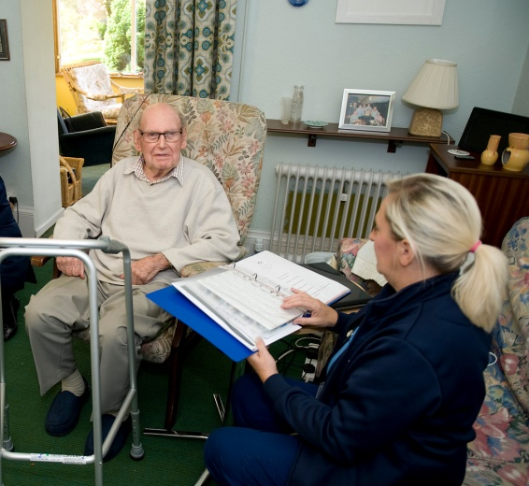
Better Engagement means:
Enhanced service user experience & outcomes
Fewer errors
Lower infection rates
Lower mortality rates
Notes:
If presentation is to LA staff consider whether to omit data on infection and mortality rates
From a service user’s perspective, evidence shows that higher staff engagement results in:
Enhanced service user experience & outcomes
Fewer errors (48%)
Lower infection rates
Lower mortality (7%)
Highly engaged staff are more likely to raise concerns about care than their disengaged colleagues.
Importantly, particularly for those of you who are not directly patient facing, it is not just those with direct contact that impact on these benefits to service users. It takes everyone within the organisation to generate these benefits. Our teams and departments are all interlinked and each team or department affects those linked to it.
The study by the Dept of Health and Gallop showed teams with high engagement had 48% fewer safety incidents or errors – so for those teams it was not just the harm or risk that didn’t happen…it was everything else that also goes along with an error (incident recording, investigations, reviews, re-learning etc).
And most strikingly it was found that organisations with high engagement had 7% lower mortality rates than those with low engagement.
Evidence base is compelling – is this reflected in your experiences?
Would this evidence help convince any cynics in your teams that it was worth working together to improve engagement?
If not, what might convince them?
Key references:
Prof Michael West at the Kings Fund and formerly of Lancaster University Business School on engagement, teamwork and culture
http://www.kingsfund.org.uk/sites/files/kf/employee-engagement-nhs-performance-west-dawson-leadership-review2012-paper.pdf
Prof Derek Mowbray of Northumbria University engagement and wellbeing at work/
http://www.mas.org.uk/positive-work-culture/wellbeing.html

Slide 11
Levels of Engagement
Engaged – employees work with passion and feel a profound connection to their organisation
Not-Engaged – employees are ‘sleep walking’ through the day, they are putting in time but no passion
Actively Disengaged – employees are unhappy at work and actively express this unhappiness by undermining the work done by colleagues
Notes:
During their large study Gallup identified three categories of engagement:
What percentage of the workforce do you estimate is in each category?
Gallup found - 20%, 60%, 20% - so 80% of the general workforce is not in the ideal state…
If you had a computer system where only 20% of the computers worked well, with 60% really slow and a bit unreliable and 20% not working at all and infecting the other computers with viruses – it is hard to imagine not taking action to improve things. Why should it be any different for people not in the ideal state?
Do you recognise any of this? How does it feel in your team?

Slide 12
Security
Team Working
Trust
Involvement
Encouragement
Communication
Engagement
High performance
Career Opportunity
Commitment
Uncertainty
Boredom
Rotten culture
Heavy Workload
No involvement
Poor relationships
Poor performance
Presenteeism
Harassment
Rigid working practices
Exhaustion
No challenge
Discrimination
Conflict
Absence, resignation
Procedures
Occupational Health
Policies
Employee Assistance Programmes
“escape”
MAS
Notes:
This is an illustration of working life developed by Professor Derek Mowbray. At the top of this picture is what you would expect from a team with high engagement. The team will be energised, enthusiastic, offer unsolicited ideas, vibrant and a great sense of well being. When people do leave the team it is a positive choice to benefit their development. These are the conditions that are linked to high performance.
However, if a manager or team do not focus on developing and maintaining their engagement there will be an inevitable ‘slide’ down the model. Eventually this will lead to what Mowbray calls ‘psychological presenteeism’ (similar to the ‘Not Engaged’ group) who come to work, do what is asked of them...but no more. These are the conditions that would be linked to poor performance. This is an unpleasant place to be and it is natural, if there is not support to move up the model, that people would look to ‘escape’ – this is where you would experience significant or long term absence and staff leaving the team, despite having nowhere in particular to go to (“anywhere but here”).
Is this pattern recognisable to you & your team?

Slide 13
How would you describe an engaging manager?
Notes:
How would you describe an engaging manager?
DISCUSSION:
Can you think of a manager that you have found engaging? What skills or qualities did that have that made a difference to you?

Slide 14
Institute of Employment Studies (2009)
found that Engaging Managers were:
Approachable, honest and open
Demonstrates an understanding of the possible impact of changes or decisions on employees
Has a good approach to managing performance, giving praise and recognition
Effective in their use of appraisals and one-to-ones, encouraging teams and giving feedback
Ensures access to resources, passing on knowledge and skills
Supports individual development, providing training opportunities and challenging work
Effectively tackles poor performance as soon as it occurs by being firm and clear about standards expected, taking action quickly but fairly
Are you this manager?
Notes:
Institute of Employment Studies (2009) found that Engaging Managers were:
Approachable, honest and open
Demonstrates an understanding of the possible impact of changes or decisions on employees
Has a good approach to managing performance, giving praise and recognition
Effective in their use of appraisals and one-to-ones, encouraging teams and giving feedback
Ensures access to resources, passing on knowledge and skills
Supports individual development, providing training opportunities and challenging work
Effectively tackles poor performance as soon as it occurs by being firm and clear about standards expected, taking action quickly but fairly
Are you this manager? What would those in your team think?
Research has shown that 80% of the variation in engagement levels is down to the line manager. (Reference – Accenture (2009) in their statement to the MacLeod Review following in-house research)
What do you want for your team? What do you need to do to achieve that?

Slide 15
Purpose
Process
Notes:
For this next section we are going to focus on the process of iMatter and your role as a manager/ team leader/ supervisor.

Slide 16
Staff Experience Management/ Staff Experience Awareness Sessions
Awareness sessions
Sharing Learning
‘iMatter’ Questionnaire
Monitoring & Review of Actions
Team Report Received
Staff Experience Continuous Improvement Model
Action Plan Agreed & Signed Off by Team
Report Discussed with Team
Team Agree Areas of Improvement
Staff Experience Continuous Improvement Cycle, Crown Copyright 2013. Contains public sector information licensed under the Open Government License v1.0.
Notes:
On a practical level - This is the Staff Experience Continuous Improvement Cycle.
iMatter has been developed as a model for supporting continuous improvement in staff experience and employee engagement.
It is for use at team level to help promote openness and transparency in your teams about your experience at work, and support your team’s development over time.
It is designed to help your line manager to understand what it is like for you as an individual at work, in your teams and the HSCPh.
It recognises that there is already a lot that is good about our teams and our workplace, but we should always be looking to learn and improve.
Ownership of the data and of planning improvements in what you do on a day to day basis sits with you, in your teams.

Slide 17
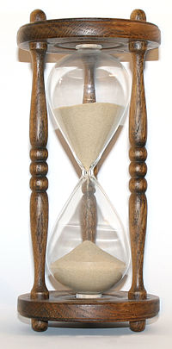
Insert local timescales for roll-out
Notes:
Insert local timescales for roll-out in HSCP

Slide 18
First Steps
Development of Organisational Charts
Initial conversations
Charts submitted
Charts prepared for national submission
Notes:
iMatter does not ‘belong’ to the iMatter team, Organisational Development, Human Resources, the Chief Officer or anyone else – it belongs to each and every team in the organisation.
Prior to implementation, it is necessary for services to prepare organisational charts that makes the line management and team structure clear. These are uploaded by the iMatter team to a national IT portal (managed independently by a company called Webropol) which provides the electronic ‘home’ for iMatter.
Team structures need to be discussed with the people involved – all staff need to be aware! The deadline for this piece of work is xxxxxxxx. You have been identified by your service as being line managers for your teams. iMatter can be most effective and meaningful when ownership of reports and action plans is at the smallest fraction of the organisation structure.
Discussion - What’s your thoughts on this?

Slide 19
Staff Experience Management/ Staff Experience Awareness Sessions
Awareness sessions
Sharing Learning
‘iMatter’ Questionnaire
Monitoring & Review of Actions
Team Report Received
Staff Experience Continuous Improvement Model
Action Plan Agreed & Signed Off by Team
Report Discussed with Team
Team Agree Areas of Improvement
Staff Experience Continuous Improvement Cycle, Crown Copyright 2013. Contains public sector information licensed under the Open Government License v1.0.
Notes:
On a practical level - This is the Staff Experience Continuous Improvement Cycle
Preparation for the cycle
The first stage that most people will be aware of iMatter is when they attend a Staff Awareness session or a Managers’ Workshop like this one.
We would encourage you to take ownership of the conversations with staff, as you know your teams and can make the discussions more bespoke to your workplace.
We know from previous cohorts that areas where more people attended the sessions, teams got higher response rates to the iMatter questionnaire – so as a manager it is vital that you ensure as many of your staff as possible attend the sessions.
Questions to consider just now:
How are you going to raise awareness with your staff?
What will your staff want to know? What is the best way to share information with them?
What barriers could there be to their participation?
What will you need to put in place to get past these barriers?
If you discuss for 5 minutes just now, thinking of your own team and how they are currently organised.
[After discussion] – You might find it helpful to consider this further after today to ensure you can create the conditions for iMatter within your team.
The iMatter IT Portal holds all the documents and information for iMatter, and there will be regular communication issued on what you need to do and when. You therefore need to ensure you access your emails regularly.
4 weeks prior to the questionnaire (xxx date), managers will be asked to confirm their team details on the IT portal, and select whether staff wish to respond either electronically or by hard copy. Staff need to be consulted as to which format they would prefer. Staff can choose to receive their electronic copy to a personal email address if they wish. Further information will be provided in an email when team confirmations open.
Each team manager will have their own private homepage to bring together all information about that team.
It will show your results over time (once you have been through cycle more than once).
Each manager will only be able to see their own Team and Directorate reports.
Team Reports
You will receive your team report 2 weeks after the questionnaire has closed – by e-mail and on portal. We will have a look at a sample report in a moment.
The next stage is to share this report with your team. For the majority of managers this will not cause any concern, but for some (particularly where there is low engagement) discussing the report with team members might require a different type of communication than the manager, or team, are used to. A number of different supports are available across the organisation to support managers to do this (e.g. Drop-in sessions, Engagement Matter series, HR, Staffnet page signposting). In exceptional cases external support to facilitate the discussion with the team may be necessary.
The report is shared with staff as soon as possible after receiving it. And certainly prior to meeting with them. This allows them to digest the information and consider their own ideas for meaningful discussion at the meeting. National guidance is that the meeting should normally take place within 4 weeks of receiving the report. [If any queries, then staff should be aware and in agreement with any delay).
The team then agree what areas they would like to focus on this year (remembering this is an annual process) and how they are going to do this. iMatter looks for teams to bring together an action plan of 1-3 actions, (certainly not an action for all 29 questions!). They agree who is going to do what, when and how they are going to monitor and support it.
[Give couple of anonymised real-life examples from earlier cohorts]

Slide 20
iMatter Questionnaire
About me
My team / line manager
My organisation
Notes:
The iMatter Questionnaire will be issued to staff on xxxx
There are 29 questions – in 3 sections focused on me / my team & direct line manager / the organisation on a sliding scale from Strongly Agree to Strongly Disagree.
Please note there is no space for free text.
Previous Cohorts report generally taking 5-10 minutes to complete
For each team the questionnaire will be open for 3 weeks (this will be the same three weeks for everyone in each phase)
Is this just a fancy name for a staff survey? How is it different?
- Ongoing process (yearly)
-Specific information for each team (ownership)
- Quick turnaround – results in weeks...not months
- Focus on improvement and celebration, not blame and ranking.
DISCUSSION:
Thinking about your specific teams:
What considerations will there be for your team when it is their opportunity to complete the questionnaire, e.g.
time (A/L, time away from duties, term time working),
Facilities – privacy, access to computers,
Literacy?
What could you do in your team to get the best response rate possible?
It is important to stress to staff that the questionnaire is anonymous. Although the paper copy has a barcode, the barcode only identifies the team that the staff member belongs to NOT who they are. It is important that staff do not deface the barcode as Webropol then don’t know which team to equate the results of the questionnaire to. It is also important that staff complete ALL the questions otherwise the questionnaire is rendered invalid.

Slide 21
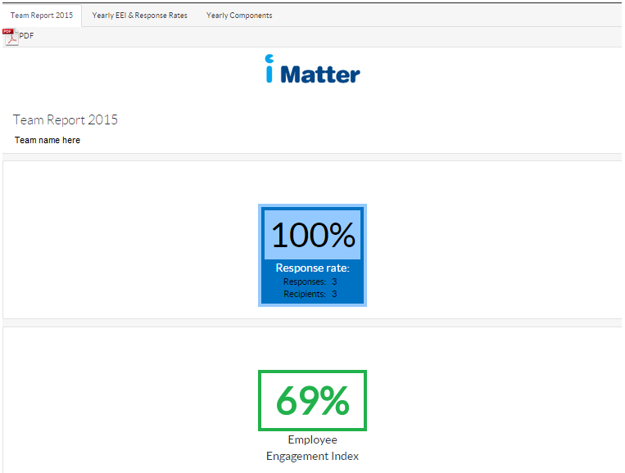
Understanding your team report
Notes:
[OPTIONAL - HAND OUT SAMPLE REPORTS]
Understanding the Team Report
You will receive your team report xx weeks after the questionnaire has closed (xx date) – by e-mail and on portal. We will have a look at a sample report in a moment.
Teams require 60% response rate for teams of 5 and more and 100% for teams of 4 or less to generate a team report. This is to ensure anonymity and the higher the response rate, the more realistic the feedback about how staff feel working in this team.
The EEI score is generated by the webropol system calculated using a formula and based on the responses received form the 28 questions. The scoring system was validated by the University of West of Scotland during the pilot stage
The first section of the report shows:
your team’s completion rate
the overall team employee engagement index (EEI) score
The headline piece of information is the Employee Engagement Index (EEI) – this is a percentage that reflects the level of engagement within the team. The response is also broken down and mapped to the staff governance standards and to each individual question. These are coloured to help get a sense of the results at a glance. [This will need updated once the reports are revised for HSCP cohorts]
The 29th question provides an indication of how the team feels overall about its experience at work – as a temperature check. This is shown on the thermometer at the final page of the report.
The pilot shows this typically correlates strongly with the EEI score. This means that the answers to questions 1-28 are a reliable predictor of the answer to question 29, and vice versa.
At the bottom of this page is the distribution of teams in the HSCP– this allows you to benchmark your scores against others in the Partnership.
Colour coding is used to visually display the responses and outcomes.
It is easy to jump straight to look at the reds...but a focus on celebrating the greens and identifying what the team does really well helps to set a tone focused on improvement...not blame. Considering the yellows & ambers might help identify areas that could be nudged towards green – a ‘quick win’ might help the team realise their potential and help them work together on issues that they find more challenging.
This information is for the team to use and there are no thresholds or targets to meet (although obviously the higher the better!).
Discuss how to view the short 2 minute video tutorials regarding team reports.
The next stage is to share this report with your team. For the majority of managers this will not cause any concern, but for some (particularly where there is low engagement) discussing the report with team members might require a different type of communication than the manager, or team, are used to. A number of different supports are available across the organisation to support managers to do this (e.g.xxxxxxx).
The report is shared with staff as soon as possible after receiving it. And certainly prior to meeting with them. This allows them to digest the information and consider their own ideas for meaningful discussion at the meeting.
The team then agree what areas they would like to focus on this year (remembering this is an annual process) and how they are going to do this. iMatter looks for teams to bring together an action plan of 1-3 actions, (certainly not an action for all 29 questions!). They agree who is going to do what, when and how they are going to monitor and support it.

Slide 22
Sample Reports:
What would stand out for you in these reports?
What does this team report tell you overall in terms of potential strengths and areas for improvements?
What would you need to consider when sharing these results with your team?
How could you create ownership of the results?
How will decisions be made? By Whom?
Notes:
Take some time to consider the sample reports using these questions – thinking of your own team. [15-20 minutes in groups]
Collate feedback on flipcharts.
We often get asked about teams where managers don’t think we will all be able to meet together to discuss the report:
Ideally the whole team would be together to discuss the report at the same time. However, in some teams this will not be practical due to shift working, service commitments, location etc. If this affects your team consider how you might have the discussion in another way & then collate the themes across the whole group:
Smaller group discussions (by shift/location)
Virtual discussions (e.g. e-mail, Survey Monkey or other software)
Using message/notice boards to gather information.
Creating Ownership – Involvement in discussions, using Communication methods normally used. Encouraging participation feedback etc.

Slide 23
“So now that we’ve dealt with the last lot of staff who gave me negative feedback, I’m really keen to hear your honest feedback about working in this team…”
Notes:
– Filling out a survey again! So what?! A word of caution for managers… 2 mins
Sound familiar? This is your chance to listen to the feedback, respond and act positively to make things better for staff which in turn improves the service user experience. How we ask for feedback is just as important as what we ask!
And doing nothing with staff feedback is NOT an option with iMatter.
Remember the feedback and stats are only a snapshot in time and may depend on how the individual felt at the time.

Slide 24
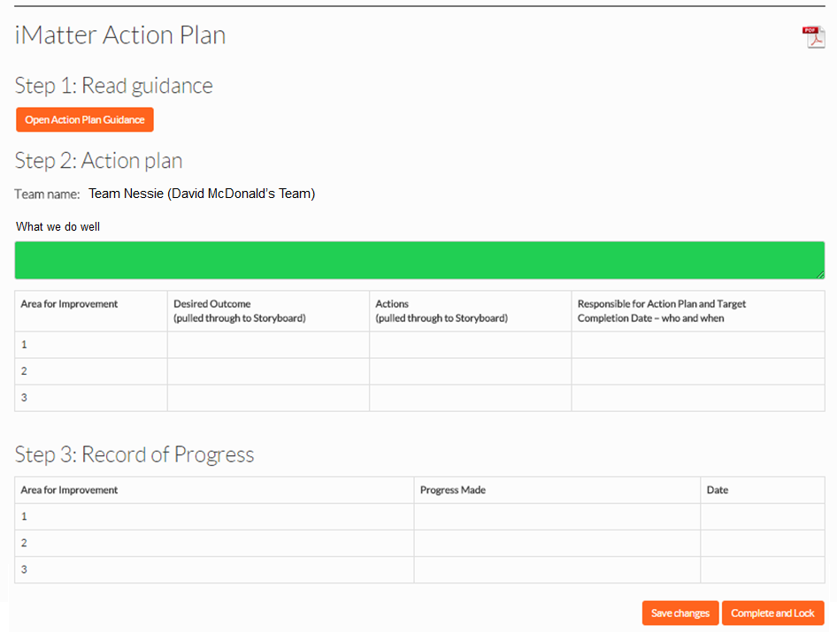
Part 2 of action plan to be inserted
Notes:
This is a screenshot of the Action Plan and Monitoring page. As you can see there is no requirement to write long reports and there is space for up to 3 actions – Up to 200 characters for each action.
Think about scheduling meetings now in advance of your team report issue date...remember this should be shared as early as possible after receiving it. Staff feedback so far has indicated some are not receiving this nor being involved in the Action planning at all, which completely defeats the purpose and can lead to active disengagement in the team.
If your team has not reached a response rate sufficient to generate a report then the Directorate report should be used as the basis for team conversations, and an action plan still requires be developed following team discussions.
It is recommended that the team manager and their line manager engages in conversation about their EEI score and Team Action Plan as part of local communication processes and particularly KSF PDR/ Exec appraisal processes.

Slide 25
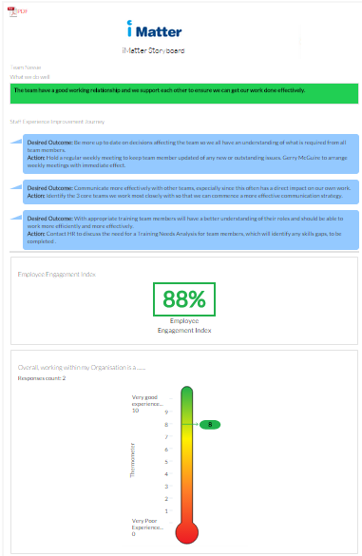
Storyboard
Notes:
This is an example of the Story board that can be produced using the iMatter portal. This can be used as a visual reminder of the team’s discussion & agreement to put in communal areas.
More information will be shared about this as you embark on the iMatter journey.

Slide 26
Managers Checklist:
Over the coming weeks, consider if you have :
Created opportunities for staff to become aware of iMatter
Provided your organisational charts and confirmed your team details on the IT portal
Proactively encouraged participation from your whole team to the iMatter process and completing the iMatter Questionnaire?
Shared the Team Report at a feedback session with your whole team?
Created local shared ownership of your specific Team Action Plan and inputted your Team Action Plan on the iMatter Portal?
Committed to progressing your Team Action Plan in terms of time, focus and resources.
Notes:
In summary: The role of the team manager in the implementation of iMatter, consider….
[either manager talking or soundbites/video whilst slide on screen]
Have you:
Encouraged your staff to attend an iMatter Awareness Session
Provided your organisational charts and confirmed your team details on the IT portal
Proactively encouraged participation from your whole team to the iMatter process and completing the iMatter Questionnaire?
Shared the Team Report at a feedback session with your whole team?
Created local shared ownership of your specific Team Action Plan and inputted your Team Action Plan on the iMatter Portal?
Committed to progressing your Team Action Plan in terms of time, focus and resources.

Slide 27
Support
Key contacts:
Resources:
e.g. Local intranet, national webpage etc
Notes:
Insert local contacts etc.

Slide 28
Any final questions?
Insert local image of HSCP team
Notes:
Any final questions?

