Slide 1
Insert local IJB logo
Insert revised national iMatter staff image
Implementing iMatter in xxx HSCP
Staff Awareness Session
Notes:
Welcome to this session about iMatter, the continuous improvement model that is currently being rolled out in xxx HSCP. Acknowledge that to date iMatter has been a health initiative but long-term there is benefit in extending inclusion to all working within the Health & Social Care sector.
As teams come together in new working arrangements in the HSCP, iMatter can assist in strengthening new team relationships by measuring everyone’s experience at work and coming together to develop joint actions for improvement.
Provide verbal feedback of current Board/HSCP status and implementation (optional).

Slide 2
What we are going to cover
What employee engagement is, and why it is important
How understanding staff experience can help improve it
What iMatter is, how it was developed and what it is for
How iMatter will work and what you will need to do
Answers to your questions, and how to find out more
Notes:
Over the next 30 minutes or so, we are going to cover:
What employee engagement is and why it is important to us all in the organisation
How understanding staff experience helps to improve employee engagement
An introduction to iMatter, the Staff Experience Continuous Improvement model and its online tool
How iMatter will work, what you will need to do and when
There will also be a chance for you to ask us questions and where we can’t answer these directly, there will be details on how to find out more now and as we go through the process in insert your HSCP name here.

Slide 3
Public Bodies (Joint Working) (Scotland) Act 2014
Healthy Organisational Culture
We will respond to the needs of the people we care for, adapt to new, improved ways of working, and work seamlessly, with colleagues and partner organisations.
Together, we will create a great place to work and deliver a high quality healthcare service which is among the best in the world.
People who work in health and social care services feel engaged with the work they do and are supported to continuously improve the information, support, care and treatment they provide.
Notes:
The Christie Commission report in 2011 set out the future direction for the provision of integrated Health & Social Care services.
The National Health and Wellbeing Outcomes document sets out the framework for delivering these services. Outcome 8 that you can see here is a commitment to developing a healthy organisational culture through staff engagement.
[Optional] – for those of you with an NHS background, you might be familiar with the Workforce 2020 Vision national document. There are 5 development strands, one of which is in relation to a healthy organisational culture - aimed at ensuring staff feel valued, listened to, involved in decisions and treated with dignity and respect.
There is a strong correlation between the two documents around staff experience and engagement.
iMatter has been developed by the Scottish Government as a team based employee engagement tool, and the implementation of iMatter in xxx HSCP offers an opportunity to understand where teams are currently (a baseline) in moving forward as new working arrangements become embedded in the Partnership.

Slide 4
Insert HSCP logo
Staff Governance Standards
Local Values
Informed
1.
Involved in Decisions
2.
Appropriately Trained
3.
Safe Environment
4.
Treated Equally
Notes:
Placeholder for Boards to insert slide(s) around local Culture and Values work that iMatter aligns with / supports – both NHS and Local Authority.

Slide 5
What does this mean to you?
What do you understand by the term employee engagement?
Why do you think it is important?
What will you see, hear, experience if colleagues are engaged?
Notes:
Ask participants in 5 minute plenary:
What do you understand by the term “employee engagement”?
Why do you think it is important?
What will you see, hear, and experience if you and/or you encounter colleagues who are engaged?
Look for answers such as:
Commitment to organisation’s aims, motivation to do the job well
Supports a positive and productive workplace from which service users / patients and employees benefit
Regular feedback, visible team working, ideas and suggestions being listened to and acted on
Feeling valued
Capture the responses on a flipchart so you can refer back as necessary throughout the session. This will promote ownership and gets people involved at an early stage, increasing the chance they will contribute later.

Slide 6
Better Engagement means:
Higher staff morale & motivation
Less absenteeism & stress
Stronger financial management
Greater efficiency, productivity & effectiveness
Notes:
So while this all sounds good – does it actually matter?
What impact do engaged (or non-engaged) staff have on the services we provide?
There is strong evidence of the positive impact of high employee engagement on both staff and service user experience. Some of the specific benefits for staff include:
Higher staff morale and motivation
Less absenteeism and stress
Stronger financial management
Greater efficiency, productivity and effectiveness
To give an indication of the size of these effects - a recent survey by the Dept of Health and Gallup showed that teams with high engagement had 37% less absenteeism than those with low engagement and 21% higher productivity. What kind of impact could that have in your area?
[If any queries, the study involved over 50,000 respondents across both public & private sectors, not just healthcare]
Stronger financial management comes from less absenteeism, less costs associated but it is also and being more connected to our roles we will be more likely to share our ideas for improving efficiency and productivity.
Stronger financial management is something that comes from us all. Where people feel engaged and have that connection to their team & organisation they are more likely to be creative and innovative and speak up about their ideas. We can’t necessarily influence what happens at an organisational level, but what other small changes are we missing out on at a local level because people don’t feel engaged?

Slide 7
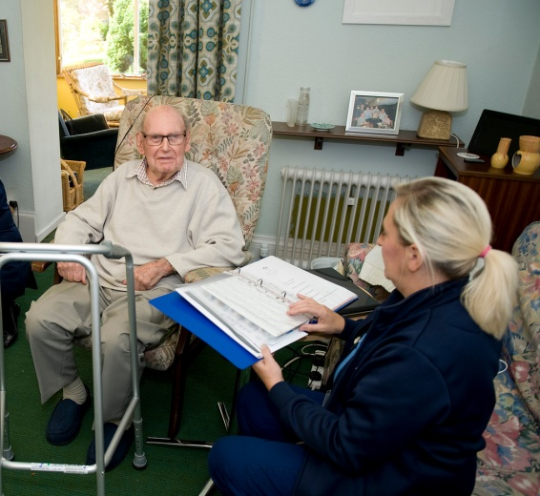
Better Engagement means:
Enhanced service user experience & outcomes
Fewer errors
Lower infection rates
Lower mortality rates
Notes:
If presentation is to LA staff consider whether to omit data on infection and mortality rates
From a service user’s perspective, evidence shows that higher staff engagement results in:
Enhanced service user experience & outcomes
Fewer errors (48%)
Lower infection rates
Lower mortality (7%)
Highly engaged staff are more likely to raise concerns about care than their disengaged colleagues.
Importantly, particularly for those of you who are not part of front-line teams, it is not just those with direct contact that impact on these benefits to service users. It takes everyone within the organisation to generate these benefits. Our teams and departments are all interlinked and each team or department affects those linked to it.
The study by the Dept of Health and Gallop showed teams with high engagement had 48% fewer safety incidents or errors – so for those teams it was not just the harm or risk that didn’t happen…it was everything else that also goes along with an error (incident recording, investigations, reviews, re-learning etc).
And most strikingly it was found that organisations with high engagement had 7% lower mortality rates than those with low engagement.
NB: For colleagues who challenge or ask for further information about the evidence base, commend the work of:
Prof Michael West at the Kings Fund and formerly of Lancaster University Business School on engagement, teamwork and culture
http://www.kingsfund.org.uk/sites/files/kf/employee-engagement-nhs-performance-west-dawson-leadership-review2012-paper.pdf
Prof Derek Mowbray of Northumbria University engagement and wellbeing at work/
http://www.mas.org.uk/positive-work-culture/wellbeing.html

Slide 8
Isn’t it the same as the Staff Survey?
iMatter drills down to Team level experience
Continuous Improvement Model
Team Report and Action Plan
Timescales
Notes:
iMatter drills down to team level experience. This is more relevant to staff than the broader themes covered by organisational staff surveys.
iMatter is a Continuous Improvement Model – not just a questionnaire. It generates a team report within 5 weeks of the questionnaire completion date. Teams are asked to discuss their report and develop an action plan within a further 12 weeks.
The Action Plan celebrates what you do well and allows the team the opportunity to work on at least one but up to three key actions for the months ahead. These need to be achievable in a given time scale and should be everyone’s responsibility to complete. Ultimately, the actions should improve the experience of the team members.

Slide 9
Staff Experience Management/ Staff Experience Awareness Sessions
Awareness sessions
Sharing Learning
‘iMatter’ Questionnaire
Monitoring & Review of Actions
Team Report Received
Staff Experience Continuous Improvement Model
Action Plan Agreed & Signed Off by Team
Report Discussed with Team
Team Agree Areas of Improvement
Staff Experience Continuous Improvement Cycle, Crown Copyright 2013. Contains public sector information licensed under the Open Government License v1.0.
Notes:
On a practical level - This is the Staff Experience Continuous Improvement Cycle.
iMatter has been developed as a model for supporting continuous improvement in staff experience and employee engagement.
It is for use at team level to help promote openness and transparency in your teams about your experience at work, and support your team’s development over time.
It is designed to help your line manager to understand what it is like for you as an individual at work, in your teams and the HSCP.
It recognises that there is already a lot that is good about our teams and our workplace, but we should always be looking to learn and improve.
Ownership of the data and of planning improvements in what you do on a day to day basis sits with you, in your teams.

Slide 10
iMatter Questionnaire
About me
My team / line manager
My organisation
Notes:
The iMatter Questionnaire will be issued to staff on xxxx
The Questionnaire asks you questions about 3 different key areas: About You, Your Team and Line Manager and the Organisation. Understanding your experience in these areas is important to determine your overall engagement level at work.
The first 28 questions are on a Likert Scale of 6 options, namely Strongly Agree, Agree, Slightly Agree, Slightly Disagree, Disagree, Strongly Disagree. The 29th is also a Likert scale with 11 options, 0-10. The question is, “Overall ,working within my Organisation is a...”. (It has been validated, through the initial pilot, by the University of the West of Scotland).
Previous Cohorts report generally taking 5-10 minutes to complete
Your manager should ask you if you would prefer electronic or paper copy (Discuss pro’s and cons). You can use a personal e-mail address if you wish. If using paper copy you will be issued with it and a SAE for Webropol, who host the iMatter system for Scottish Government.
All questions must be completed – electronic needs to be done all at once. Explain QR Barcode on paper copy and reason – don’t deface or photocopy it! Stress that both forms are anonymous.
Mention Participation Rates required to generate report. There is no ‘free text’ space. This is because the discussions around your team report are the most important aspect of the process. There is a 3 week window to complete the questionnaire.

Slide 11
Understanding your results
Team Name
SAMPLE
Notes:
In order to enable managers to feed back results in their teams they will receive a report looking like this. [to be amended if national decision taken on respondents receiving reports directly]
The report shows:
your team’s completion rate
the overall team employee engagement index (EEI) score
Teams require 60% response rate for teams of 5 and more and 100% for teams of 4 or less. This is to ensure anonymity and the higher the response rate, the more realistic the feedback about how staff feel working in this team.
The EEI score is generated by the Webropol system calculated using a formula and based on the responses received form the 28 questions. The scoring system was validated by the University of West of Scotland during the pilot stage.
Also shows:
how the team is doing in relation to the 5 strands of the Staff Governance Standard [?? Will this still be the case for IJB reports]
All questions have been linked to the staff governance standards and under each of the strands the questions have been collated to give a sense of ‘feeling’ under that strand – refer to slide 5.
the distribution of ratings across Red, Yellow, Amber, Green from all who responded
Colour coding is used to visually display the responses and outcomes.

Slide 12
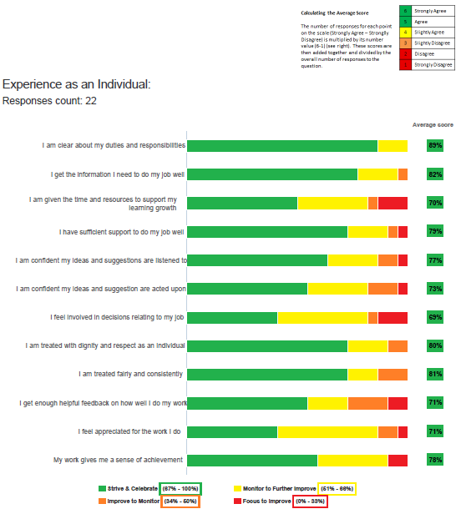
SAMPLE
Notes:
Data is provided in respect of the 28 questions under the headings of ‘as an individual’ ‘my team/line manager’ ‘my organisation’.
Answers are strongly agree / agree/ slightly agree / slightly disagree / disagree / strongly disagree. Note for scoring the positive and negative i.e. strongly agree or disagree and the agree or disagree have been combined.

Slide 13
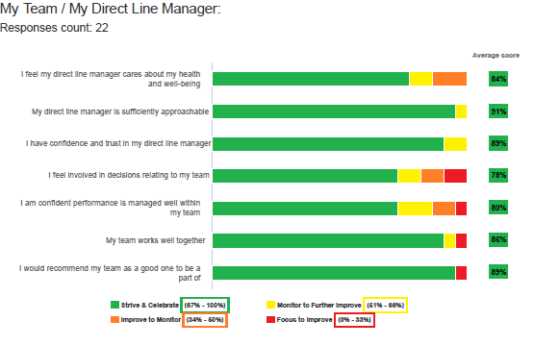
SAMPLE

Slide 14
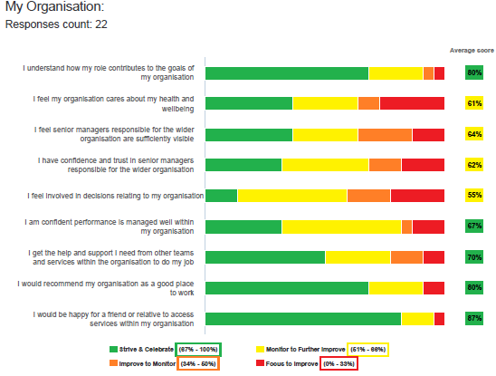
SAMPLE

Slide 15
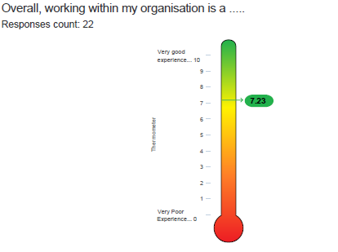
SAMPLE
Notes:
The 29th question provides an indication of how the team feels overall about its experience at work. This is shown on the thermometer at the final page of the report.
The pilot shows this typically correlates strongly with the EEI score. This means that the answers to questions 1-28 are a reliable predictor of the answer to question 29, and vice versa.
At the end of the report is a table demonstrating all the teams in a Directorate that received a report and the threshold EEI. Each team can see how they compare with other teams, but there are no team names indicated. This includes teams with no report.
Your manager should use the data to facilitate a full discussion in your team about what it is like to work in the team, understand what is good and what could be improved, and agree an action plan of up to 3 things you will do together over the coming year to achieve this.

Slide 16
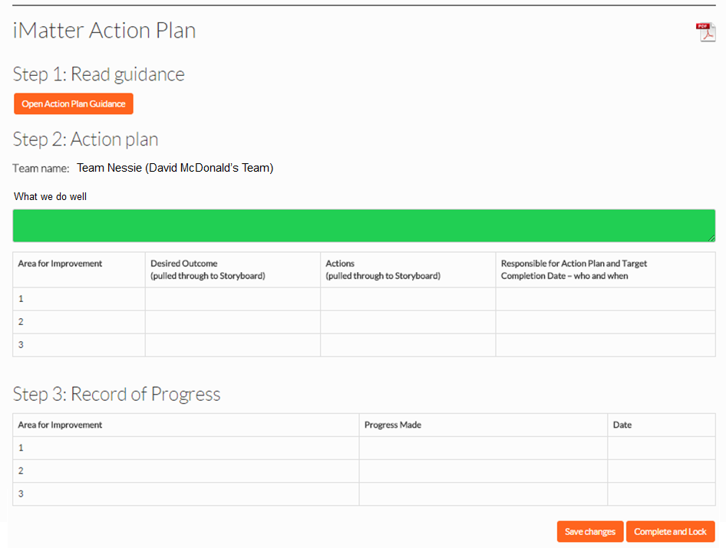
Part 2 of action plan to be inserted
Notes:
This is a screenshot of the Action Plan and Monitoring page. As you can see there is no requirement to write long reports and there is space for up to 3 actions – Up to 200 characters for each action.
If your team has not reached a response rate sufficient to generate a report then the Directorate report should be used as the basis for team conversations, and an action plan still requires be developed following team discussions.
Managers will be required to produce a copy of the Team Action Plan for all team members, reinforcing that it’s everyone’s job to work on improving staff experience and not just the managers responsibility.
You will need to discuss confidentiality with the team as the principle is not to share this information outwith the team unless this is agreed by the team itself. (Requires majority to agree, not all)
Note that as soon as the fields in the Team Action Plan are completed and locked, the system will send the information in the appropriate fields to the team’s Storyboard including the thermometer.
It is recommended that the team manager and their line manager engages in conversation about their EEI score and Team Action Plan as part of local communication processes and particularly KSF PDR/ Exec appraisal processes.

Slide 17
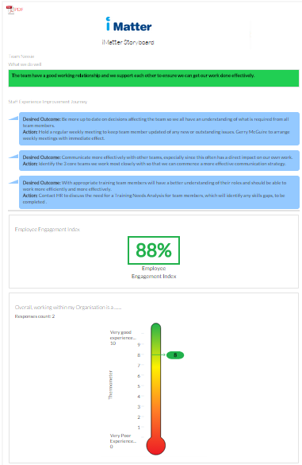
Storyboard
Notes:
A mock Storyboard is provided here to give you an idea of what this will feature. The key contents are;
The team name
Strengths/ areas for celebration
EEI score
the thermometer
Agreed improvement areas in term of outcomes and associated actions.
The Storyboard is an opportunity for teams to visually demonstrate their continuous improvement journey year on year. Managers will be encouraged to display their storyboards for staff.

Slide 18
Insert local timescales for roll-out
Notes:
Insert local timescales for roll-out in HSCP

Slide 19
Support
Key contacts:
Resources:
e.g. Local intranet, national webpage etc
Notes:
Insert local contacts etc.

Slide 20
Any final questions?
Insert local image of HSCP team
Notes:
So that provides you with an overview of iMatter, the background to its development and how it will work. Are there any questions?

